Slide 1
Sound Card Digital
on Winlink Express

Slide 2
What Winlink offers for EMCOMM
Flexibility:
Internet-only (Telnet) direct connections to Winlink.
Radio link bridge to Internet e-mail.
Radio-only store and forward messaging.
Peer-to-peer connections between radio end-users.
Familiar and simple e-mail client interface.
Interoperability: Connect different types of systems
Bridge different radio capabilities (VHF/UHF/HF).
Seamless integration with Internet e-mail.
Geographical dispersion and redundancy for reliability

Slide 3
What Winlink offers for EMCOMM (more)
Standard e-mail format with many features.
Binary file attachments (pictures, pdf, spreadsheets).
Automatic message compression/decompression.
White listing used to prevent spam.
Time independence.
Ability to collect messages while unattended.
Good operation at most power levels.
Not limited by station-to-station propagation.
Message logging, and ICS report generation.
Forms and template support.
GPS location information and mapping.
Wide adoption by EmComm related agencies.

Slide 4
Why sound card digital?
Flexibility and Performance:
Most Winlink modes are available using only a sound card interface (Packet, ARDOP, Vara HF, Vara FM)
Less expensive hardware options, may be built-in to radio
Superior decode performance over hardware devices
Not limited to just Winlink, other weak signal and experimental modes require a sound card interface (WSJT, WSPR, FT8, etc.)

Slide 5
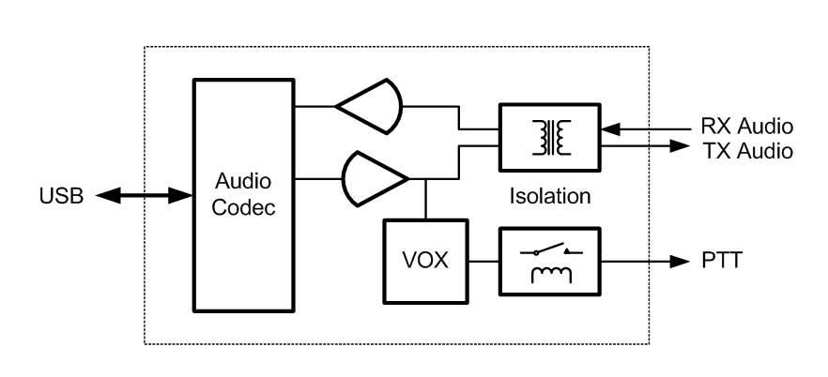
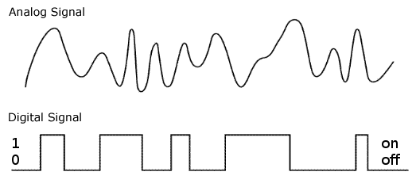
Sound card interface block diagram
(Audio)
(USB)

Slide 6
sound card operation
Interface:
Basically a simple signal interface, it is not a TNC
May provide ground isolation between radio and computer
Provides Push To Talk (PTT) signal
Does not process the modem signals
Signal processing is done by software running on the host computer
May include additional ports for rig control
Host Software:
Does signal processing (modulation/demodulation)
Provides timing of data and control signals
Implements the data protocol

Slide 7
sound card operation Winlink Express Sound Card Modes
Mode | Speed | Application
ARDOP (HF) | Up to 4000bps | Included
Vara (HF) | Up to 7,000bps | External
Packet (V/UHF) | 1200/9600bps¹ | External
Vara FM (V/UHF) | Up to 25,210bps | External
The ARDOP modem was developed by the WDT and is included with Winlink Express
Vara and Packet modes are provided by external modem applications:
Vara (HF) and Vara FM (V/UHF)
UZ7HO Soundmodem (V/UHF Packet)
Direwolf (V/UHF Packet)
1. Both Soundmodem and Direwolf provide additional PSK modes between 1200 and 9600

Slide 8
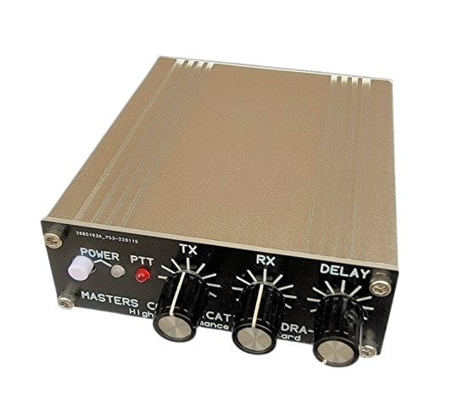
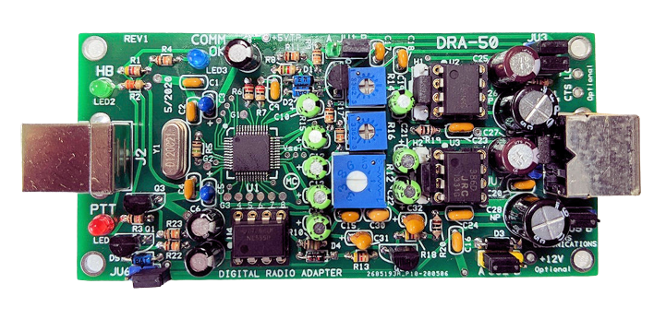
Sound card Interface
Simple device powered by USB connection.
Cost is between $50-$100 depending on features.
Radio needs to have a "data" (analog) port or use the microphone and speaker connections for lower speed.
Some modes need to run an external modem application like Direwolf or UZ7HO soundmodem (for packet) or Vara FM.

Slide 9
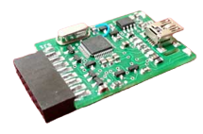
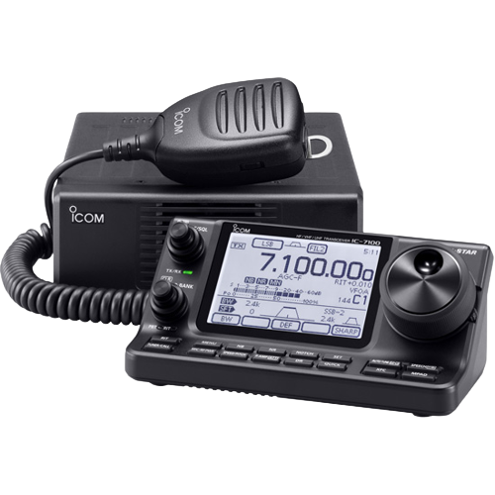
Sound card Interface options
Masters Communications DRA-50
RIM Lite
Various interfaces designed around USB codec chips (C-Media or others). May be kits, pre-built, or DIY. Many “AllStar Link” interfaces are available and will likely work fine for digital modes.
IC-7100 with built-in
sound card

Slide 10
Resources Needed for Winlink Express
V/UHF Packet/Vara FM
Windows computer, Windows 10+
Winlink Express
V/UHF radio with "data" (analog) port or speaker and mic jack
USB soundcard interface or radio with built-in sound card
Appropriate cables to connect interface to radio
External application, Soundmodem, Direwolf, Vara FM
All software is free (except Vara), but donation is suggested
Vara registration is $69/call sign or $50/call sign for groups of 10 or more

Slide 11
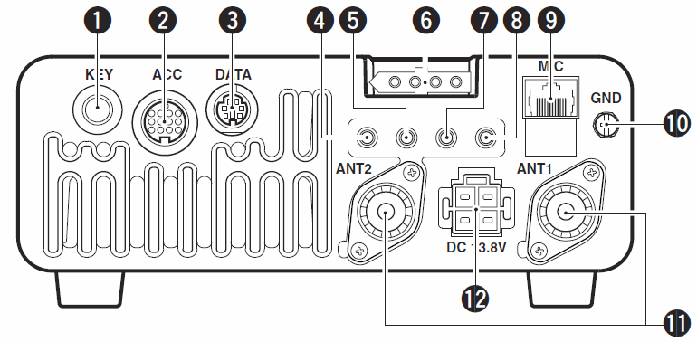
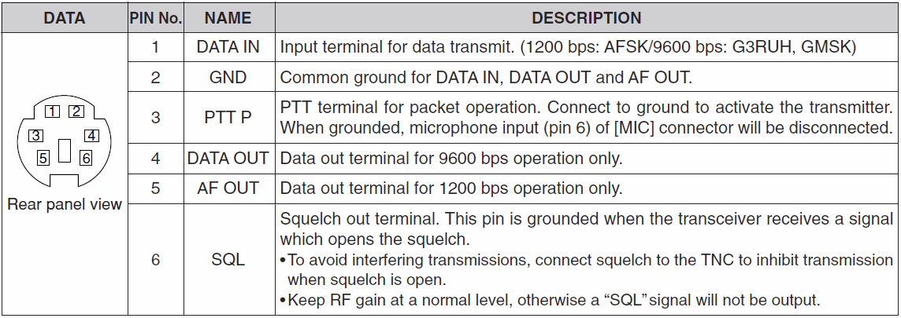
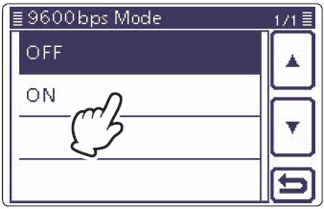
hardware Connections
Data Jack, poor name, but standard
ACC jack varies by manufacturer
1200/9600bps doesn’t really mean that
CI-V, Cat varies by manufacturer
Switching between 1200 and 9600 operation also requires menu changes
Similar modem interface as other HF digital modes.

Slide 12
hardware Connections
Data Jack (6-Pin DIN connector) explained:
Used for analog signals, not really digital signals
Not really related to 1200 or 9600 bps data rate
“1200” connections go through the regular “voice” path in the radio, including pre/de-emphasis. Audio frequency bandwidth is typically filtered to about 3kHz (voice frequencies).
“9600” connections go direct to the modulator and discriminator. Greater audio bandwidth is possible, maybe up to 6kHz.
Pin assignments are standardized; however, impedance and voltage levels are not! Some manufacturers do not even document what is expected at this jack.
Similar modem interface as other HF digital modes.

Slide 13
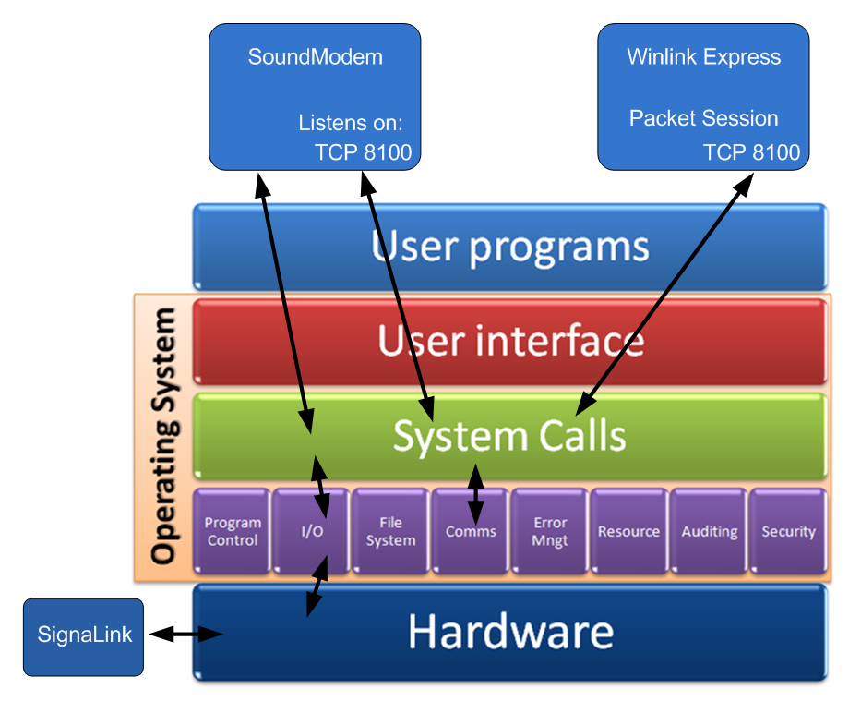
software Connections
Modem programs communicate using the OS network stack via TCP ports.
Communication stays within the system and does not go out on the LAN or the Internet.
Port numbers must match and must not conflict with other programs.
Local Host
127.0.0.1
Similar modem interface as other HF digital modes.

Slide 14
Initial Packet Setup Sound Card Interface
Using UZ7HO Soundmodem
Download zip file (UZ7HO):
http://uz7.ho.ua/packetradio.htm
Look for “Soundmodem” or “hs_soundmodem” (for 9600)
Also download the ptt-dll.zip file
Unzip to the folder of your choice
Run Soundmodem
Allow the firewall exception
Configuration settings from the drop-down menus

Slide 15
Initial Packet Setup Sound Card Interface
Using Direwolf
Download zip file (Direwolf):
https://github.com/wb2osz/direwolf/releases
Extract the program files from the zip file and run the app
Edit the CONF file to configure
Multi-platform capable, for Linux/OS-X, download the source and compile (git clone, etc.)
Perhaps build your own RasPi based soundcard hardware device

Slide 16
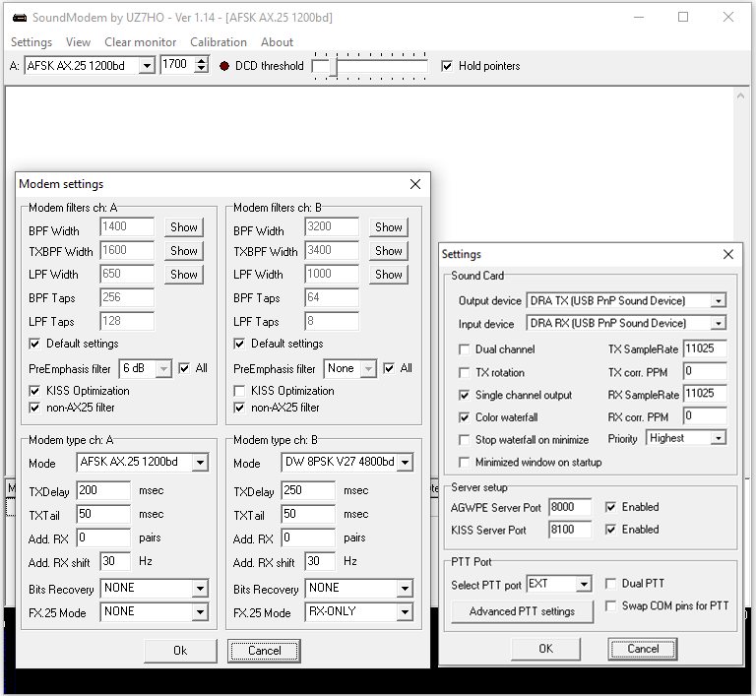
Initial Packet Setup Sound Card Interface (UZ7HO and DRA)
Run Soundmodem, then use the “Settings” drop down menus to configure devices and modem settings. Default settings will work in most cases.

Slide 17
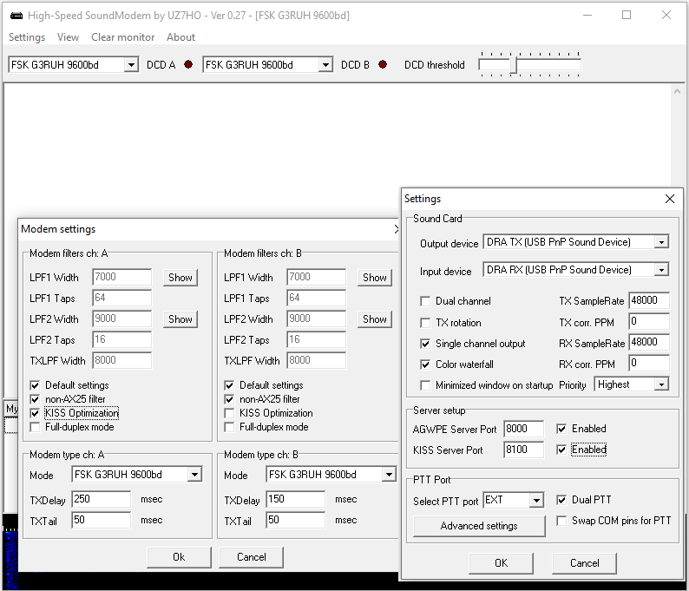
Initial Packet Setup Sound Card Interface (UZ7HO High Speed)
HS_Soundmodem is used for 9600 packet operations

Slide 18
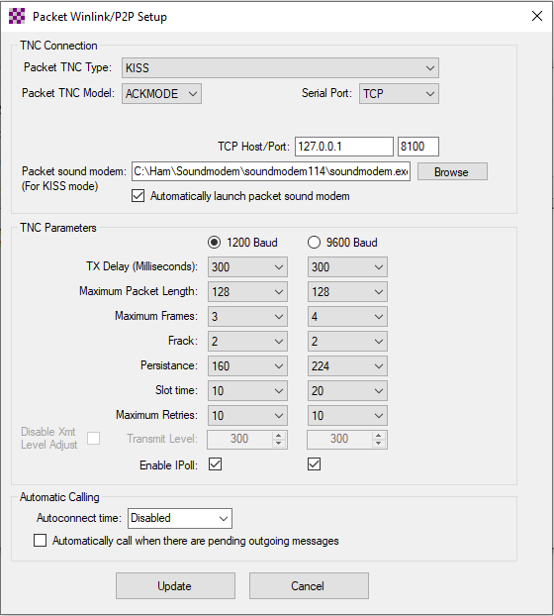
Initial Packet Setup Sound Card Interface (UZ7HO or Direwolf)
Winlink Express packet settings for TCP ports must match UZ7HO or Direwolf settings.
Winlink Express can start and close the TNC application when a packet session starts.
UZ7HO KISS supports ACKMODE, Direwolf does not.
The on-air parameters can be adjusted to improve performance, but defaults should work OK.

Slide 19
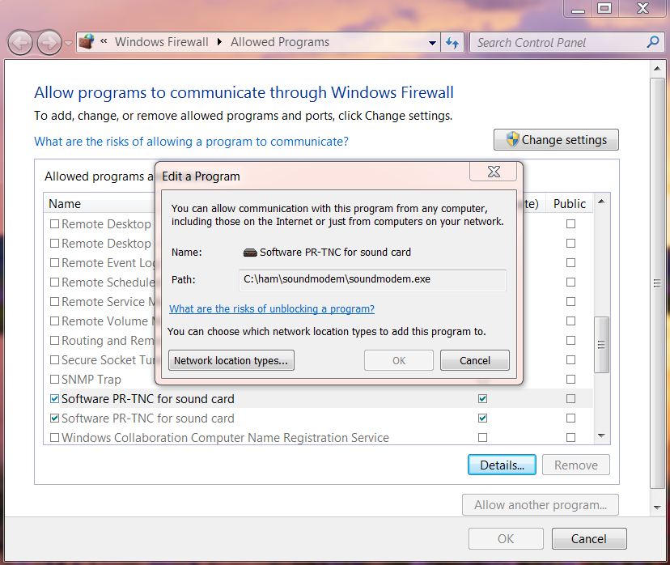
Initial Packet Setup Sound Card Interface (UZ7HO)
UZ7HO and Direwolf both
create “KISS TNC” servers within the network stack, ports on the firewall must be opened to allow Winlink Express (and other applications) to use the software TNC. You will be prompted to allow this when the application is first run, or edit the firewall settings to allow the software TNC application.

Slide 20
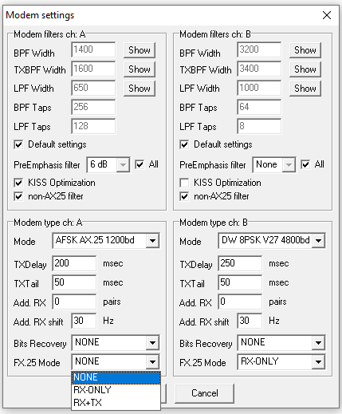
Initial Packet Setup Sound Card Interface (UZ7HO and Signalink)
UZ7HO and Direwolf both
allow for multiple modems using a “stereo” sound card, usually only modem “A” is used. Set to AFSK AX.25 1200bd modem.
Both programs can try to correct single bit errors. This is NOT advised for EMCOMM.
Both programs also now support FX.25 which adds FEC to the standard AX.25 packet frame. This is not compatible with any hardware TNC (though it is transparent) and will add overhead.

Slide 21
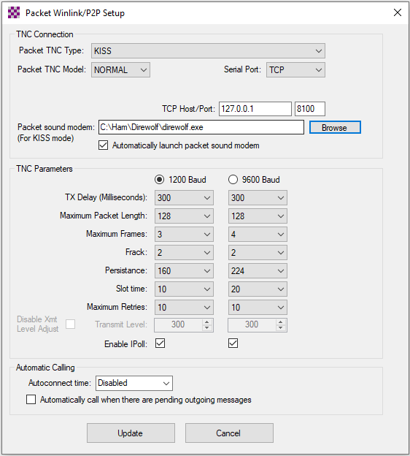
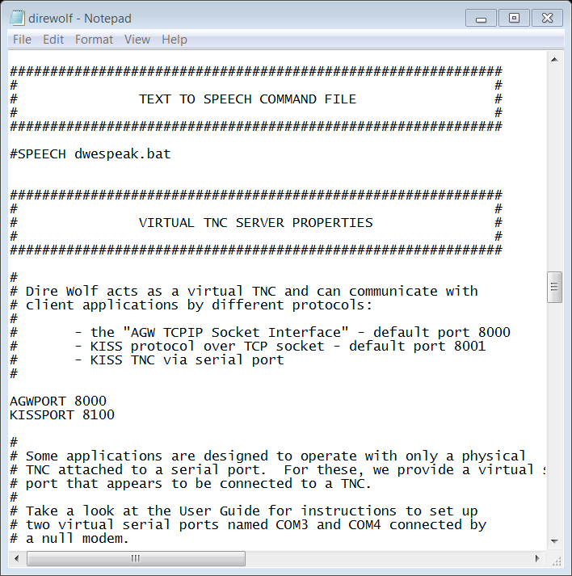
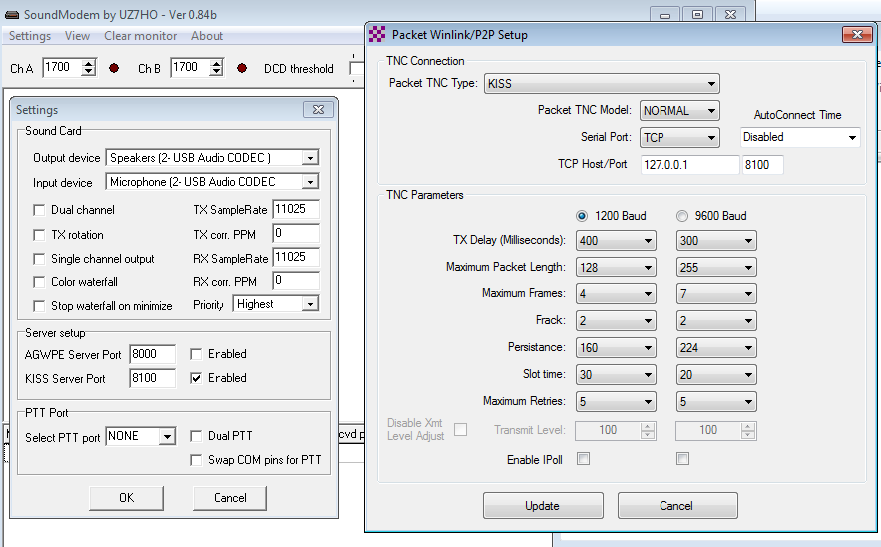
Initial Packet Setup Sound Card Interface (Direwolf)

Slide 22
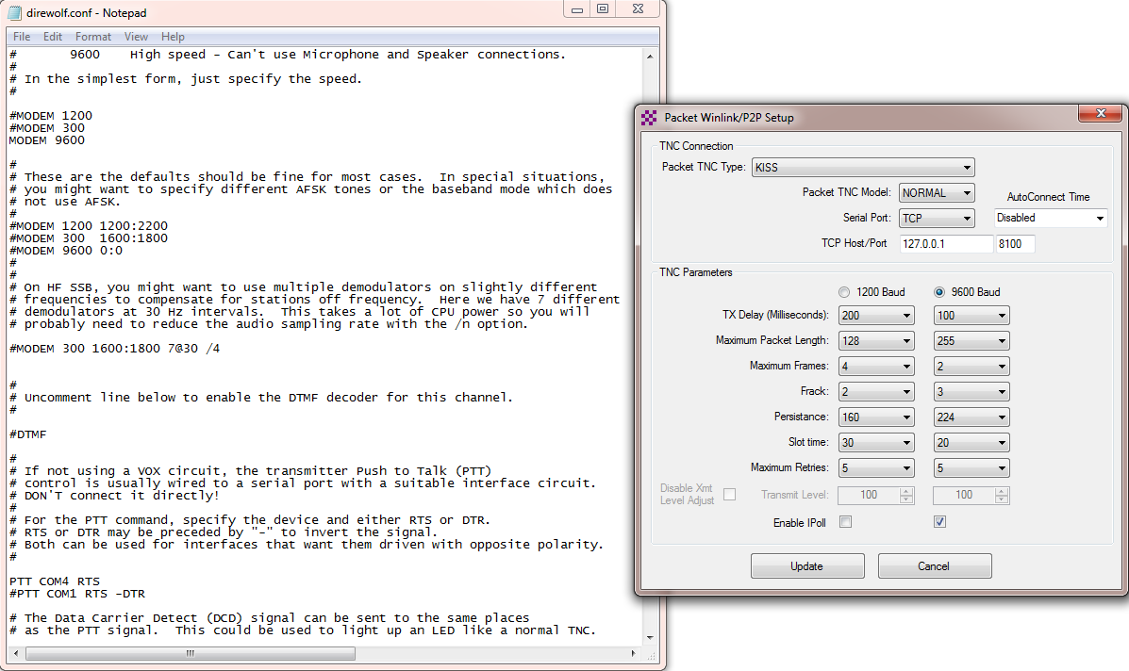
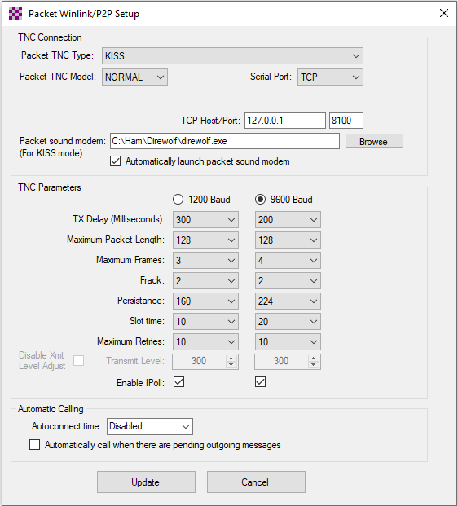
Initial Packet Setup Sound Card Interface (Direwolf High Speed)
Uncomment desired
Specify PTT port used

Slide 23
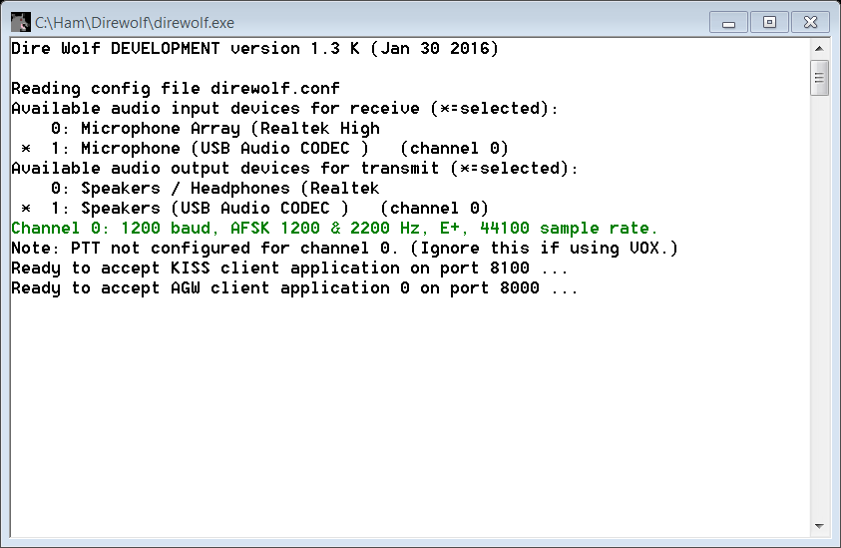
Initial Packet Setup Sound Card Interface (Direwolf)
Direwolf startup shows available audio devices. Sound cards show as USB Audio Codec.
Sound card to use needs to be set in the configuration file (there are multiple ways to do this).

Slide 24
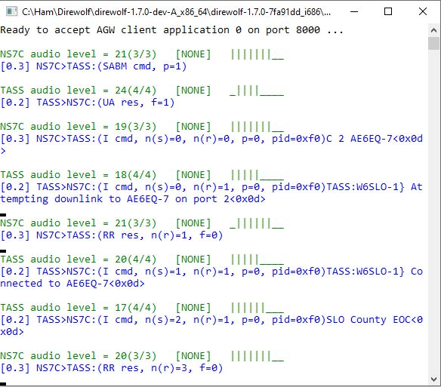
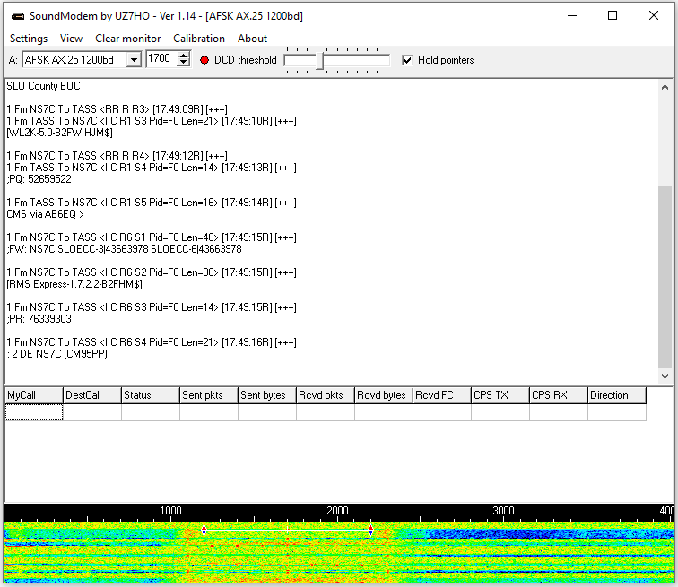
Initial Packet Setup Sound Card Virtual TNC
Direwolf and Soundmodem have different user interfaces

Slide 25
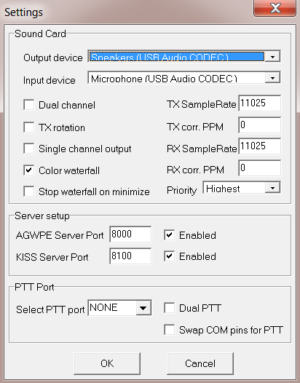
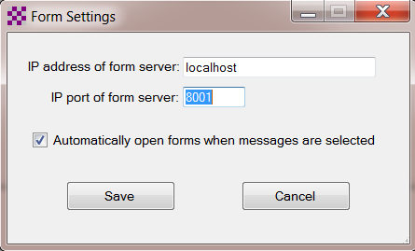
Initial Packet Setup Sound Card Virtual TNC
Make sure your Virtual TNC server TCP ports do not conflict with the Winlink Express forms server (Direwolf default KISS port settings will).

Slide 26
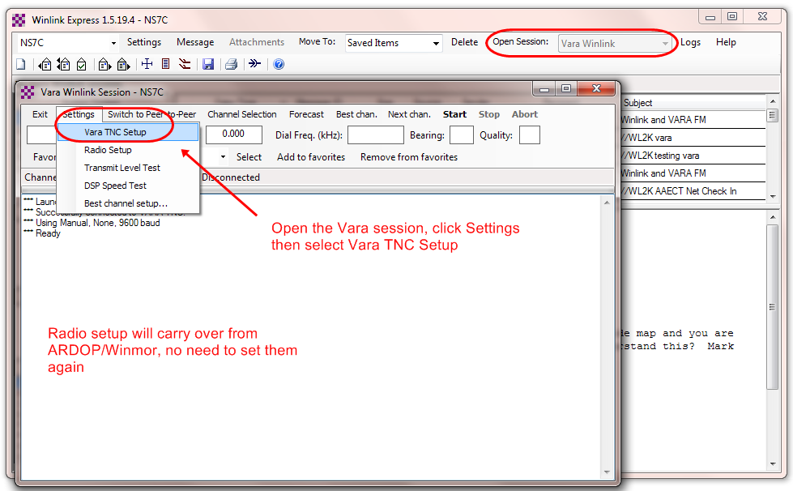
software setup vara hf
Open a Vara session, then select Settings and Vara TNC Setup. If Vara is not found on the computer in the default location, you will be given a link to the download page for Vara. The radio setup will carry over from ARDOP if you have already setup that session.
Similar modem interface as other HF digital modes.

Slide 27
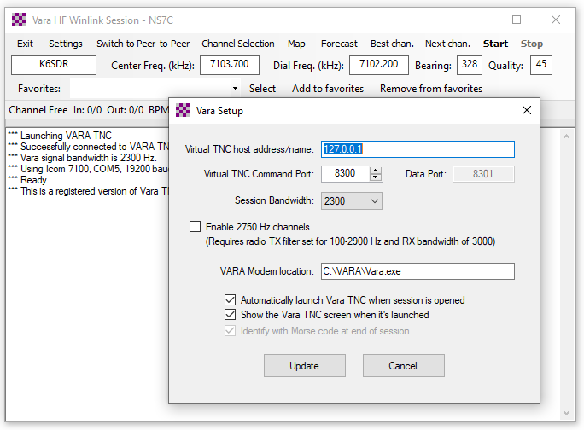
software setup vara hf
Again, accept the defaults of local host and port 8300/8301 unless you need to make a change. Select the default session bandwidth (usually 2300) and check the boxes to launch the modem automatically and start it non-minimized.
Similar modem interface as other HF digital modes.

Slide 28
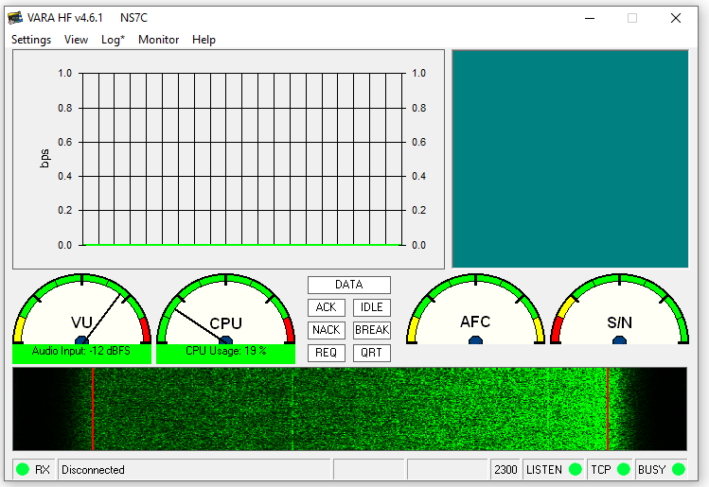
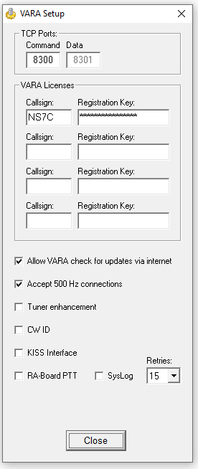
software setup vara hf
Bring up the Vara TNC, select settings and Vara Setup. Make sure the ports match the Winlink Session. Add your registration key and set retries to at least 5. If you are using a C-Media based sound card interface, select the RA-Board PTT option.
Similar modem interface as other HF digital modes.

Slide 29
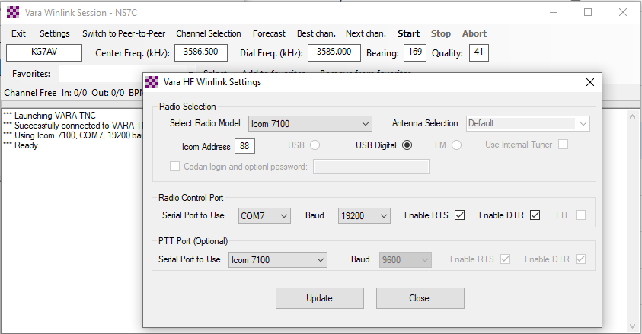
software setup vara hf
Adjust your radio selections to match your HF Rig Settings (CAT/CI-V). There are different options for PTT depending on what your rig supports.
Similar modem interface as other HF digital modes.

Slide 30
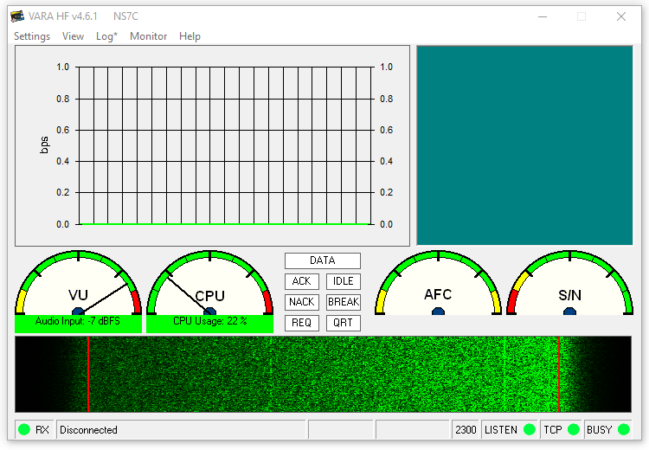
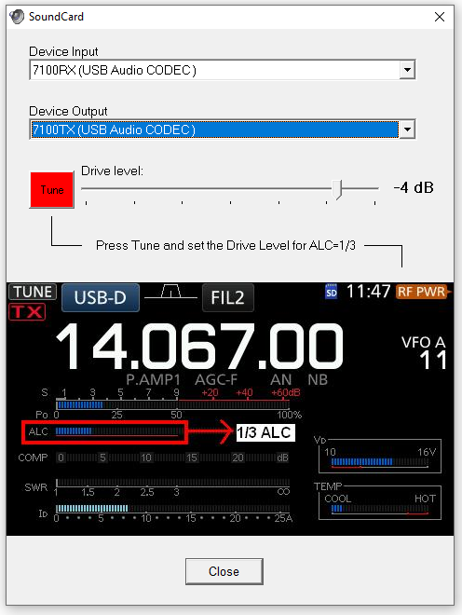
software setup vara hf
Select settings again, then Sound Card. Here you will select the sound card interface, and check/adjust the drive level. Note the tip on adjusting drive for about 1/3 scale on the ALC meter.
Similar modem interface as other HF digital modes.

Slide 31
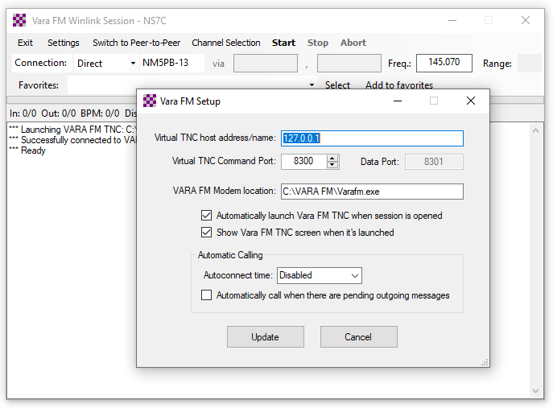
software setup Vara fm V/Uhf
Open a Vara FM session and select Settings. If Vara FM is not found on the computer in the default location, you will be given a link to the download page for Vara FM. Check the host and port settings. Select the ports and start options similar to Vara HF.
Similar modem interface as other HF digital modes.

Slide 32
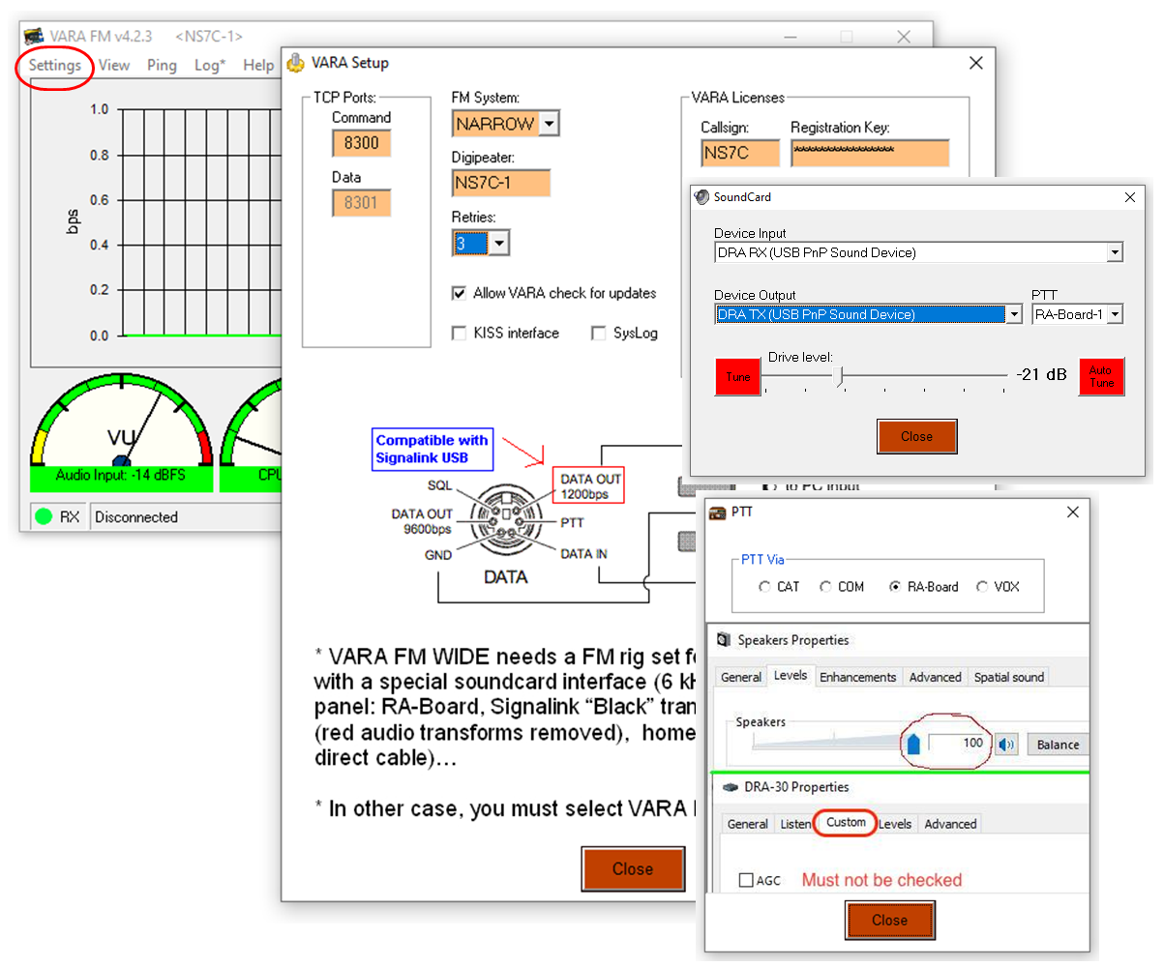
software setup Vara fm V/Uhf
On the Vara FM modem, select Settings and Vara setup. Like Vara HF, check the TCP ports, and enter the call sign and registration key. Select settings then Sound Card and select the sound card interface input and output, click on Tune and adjust the drive as needed. Select settings then PTT and select the PTT option based on your radio and sound card interface. Also note the information about AGC and levels.
Similar modem interface as other HF digital modes.

Slide 33
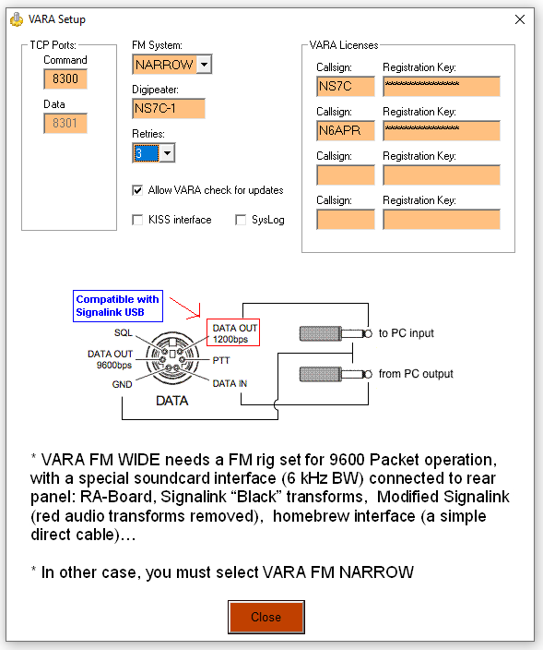
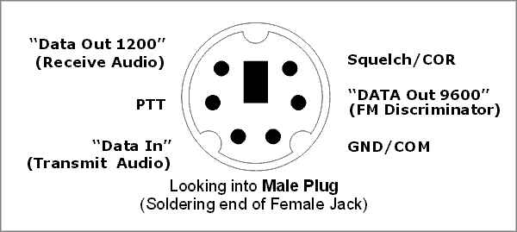
software setup Vara fm V/Uhf
Vara FM has two speed modes that are selectable within Winlink Express. Narrow mode can be used with limited bandwidth radio connections like speaker and microphone, or the “1200” pins on the data connector. Wide mode requires more audio bandwidth and must use the “9600” connection on the data connector. 9600 mode will also need to be set in the radio menus. The speed mode can be set in the setup menu, on the session screen, and also in the channel selector. Stations that are set for Wide mode can connect to Narrow stations. The mode is adjusted automatically.
Top speed on Narrow is 12,098bps
Top speed on Wide is 25,210bps
Similar modem interface as other HF digital modes.

Slide 34
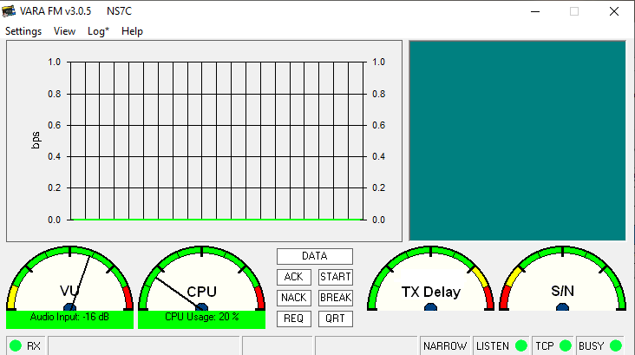
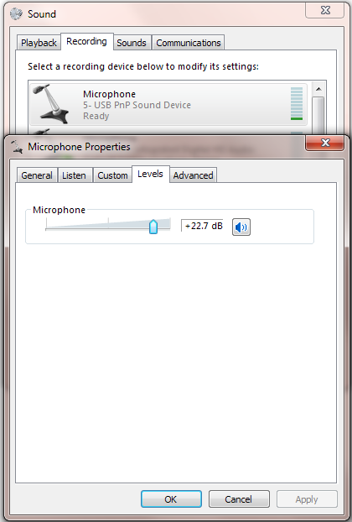
software setup Vara fm V/Uhf
The Vara FM input level should be in the 50-75% range on the VU meter. Transmit audio should be 2.5kHz (much more drive is needed for Wide connections). Adjust the TX and RX levels on the sound card interface controls, and/or the Windows mixer to achieve these levels. Some experimenting will be needed to achieve top performance. The built-in “Autotune” function will adjust the TX level automatically against a destination station. Document these settings for future reference or for resetting them after changing modes.
Similar modem interface as other HF digital modes.

Slide 35
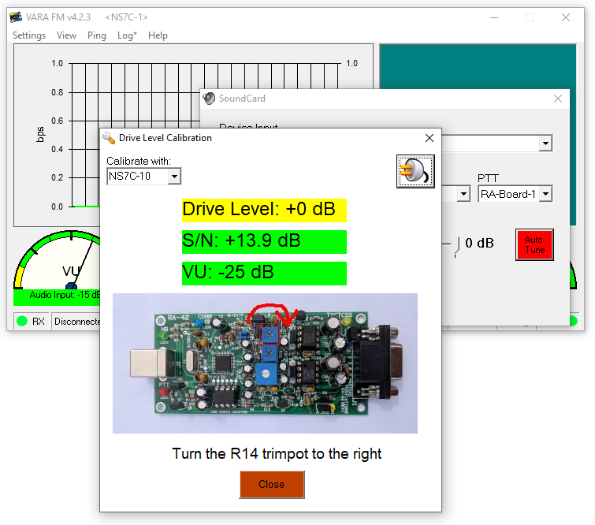
software setup Vara fm V/Uhf
The Vara FM AutoTune function assists in setting up the transmit drive level. Select AutoTune, enter the call sign of an available station to test with, and press the “plug” button. Vara FM will send a series of test transmissions, adjusting the level with each transmission. The remote station will then respond with the setting that had the best S/N ratio. Vara will adjust the drive slider to that level. If the level is too high, or too low, Vara will instruct you to adjust the level on the Windows mixer or the sound card TX controls. Green “Approved” results are good!
Similar modem interface as other HF digital modes.

Slide 36
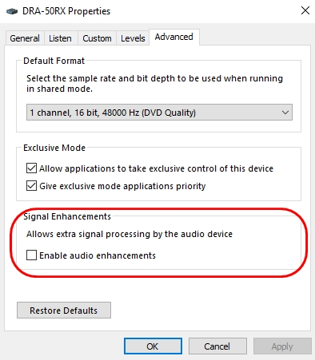
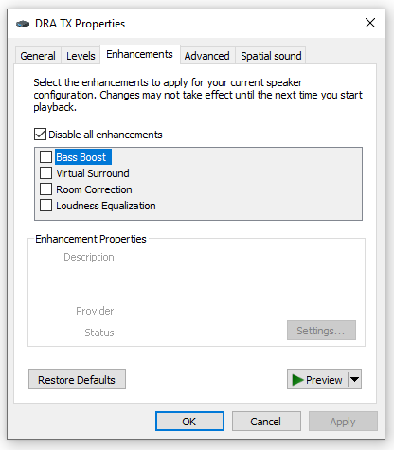
software setup Vara hf/FM
Windows Sound Settings include options to Enhance the recording and playback experience (bass boost, dynamic range, noise reduction, etc.). While these enhancements may be good for music and gaming, they are terrible for data transmission. Be sure to disable all enhancements.
Note: Create a shortcut on your desktop that calls mmsys.cpl to get directly to the sound settings.
Similar modem interface as other HF digital modes.

Slide 37
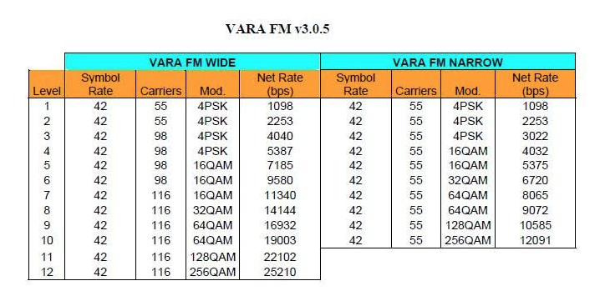
software setup Vara fm V/Uhf
Vara FM uses a very efficient FEC protocol, resulting in a significant speed improvement over traditional Packet Radio (over 2X 9600 packet). It will shift to the different speed levels automatically based on the receive signal quality.
Vara FM Narrow can also be used over regular voice repeaters or cross-band repeaters (at somewhat slower rates).
Unlike Packet, Vara FM does not support link-level network systems like network nodes, but it does have support for digipeating.
Similar modem interface as other HF digital modes.

Slide 38
Conclusion
Winlink use continues to grow, especially for EmComm use
The Winlink Development Team continues to enhance capabilities to adapt to changing needs
Steady improvements are being implemented
Sound card interfaces and modes provide low cost and high performance solutions to data transfer over RF

Slide 39
Contact
Scott Currie
NS7C
San Luis Obispo County, CA
ARES Assistant Emergency Coordinator
ns7c@arrl.net
253-569-5102

